Slide 1
Chameleon Service Training
Dieburg, 06.-10.06.2016
Laser System Overview
Part 2

Slide 2
Overview
Models & Specifications
VPUF Laser Basics
Differences between 90 & 80 MHz Platforms
Laser Safety Review

Slide 3
Chameleon Models & Specifications
Chameleon 210nm
Chameleon XR
Chameleon Ultra
Chameleon Ultra 1 & 2
Chameleon Vision 1
Chameleon Vision 2
Chameleon Vision S
Chameleon OPO
New: Chameleon Discovery

Slide 4
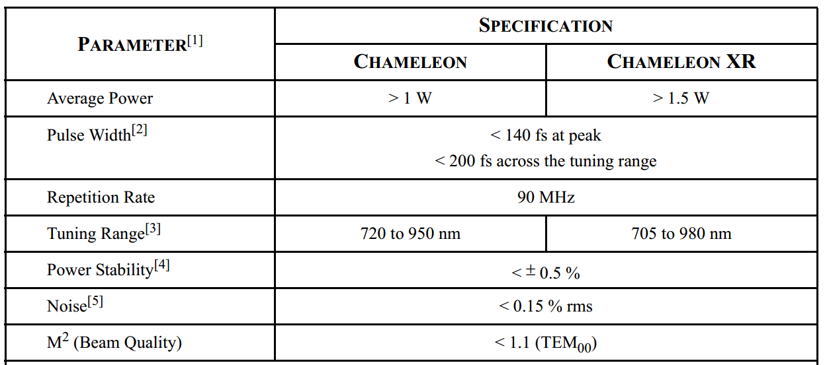
Chameleon & Chameleon XR
XR: Xtended (Tuning) Range

Slide 5
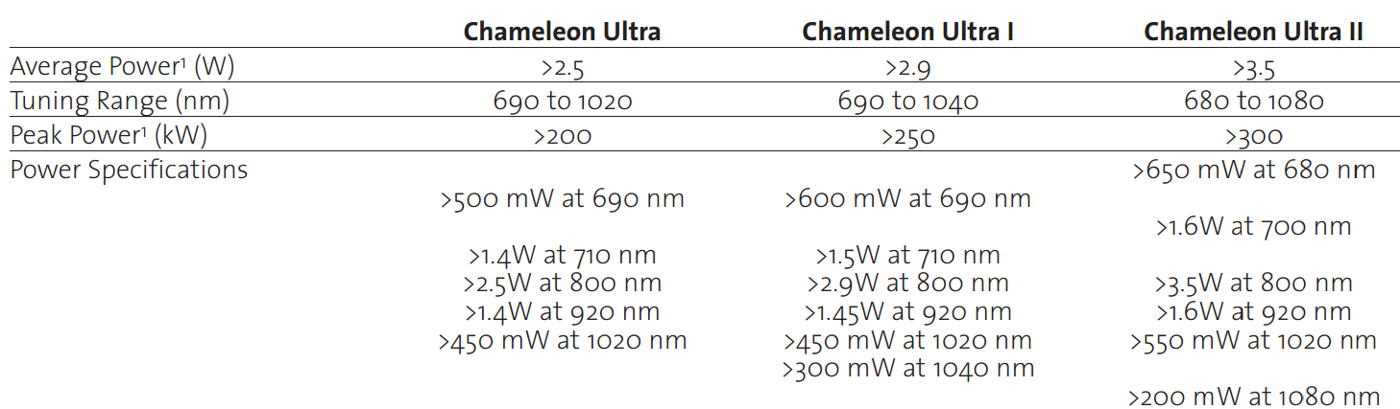
Chameleon Ultra Family
80 MHz Platform

Slide 6
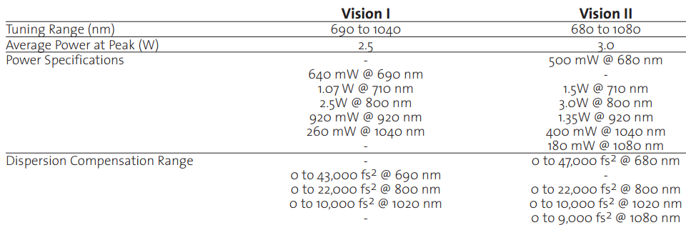
Chameleon Vision Family
Vision = Ultra 2 + GDD

Slide 7
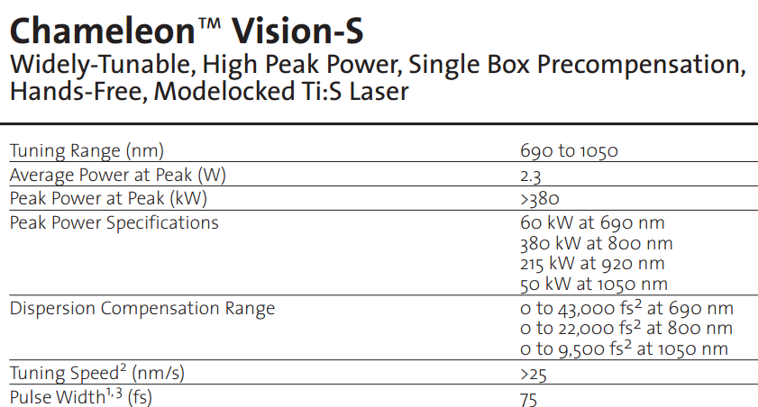
Chameleon Vision Family
Vision-S = Ultra 2 + GDD + shorter pulses

Slide 8
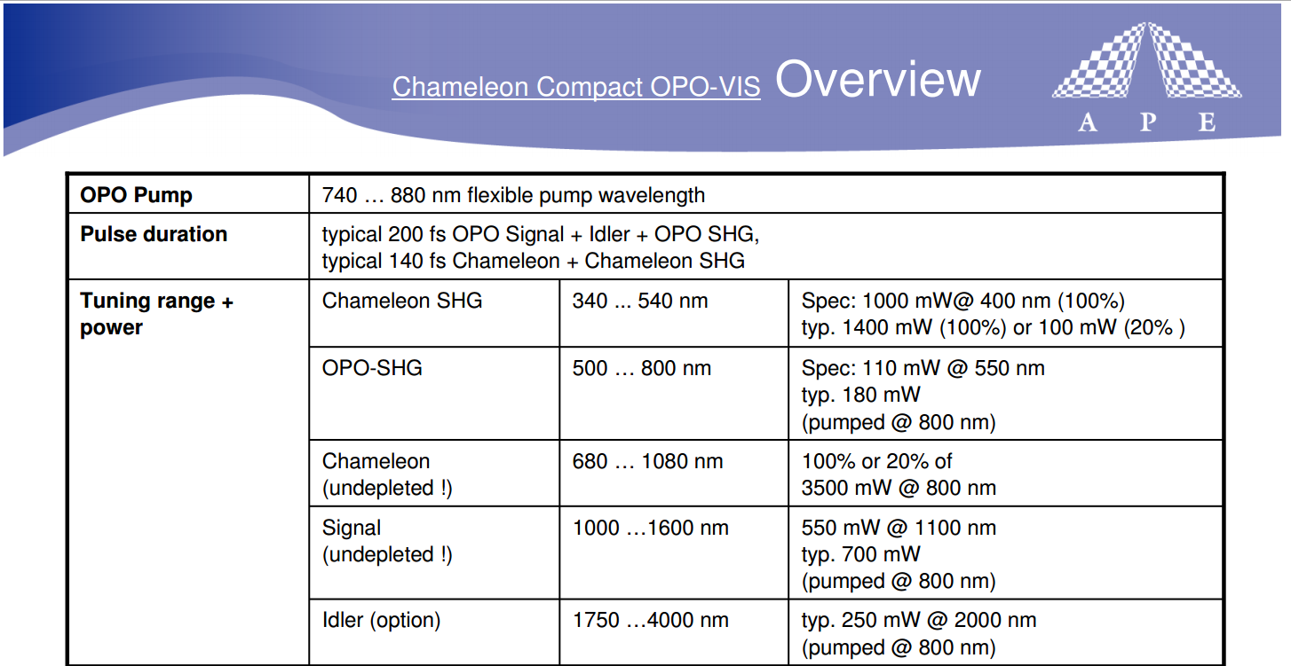
Chameleon OPO

Slide 9
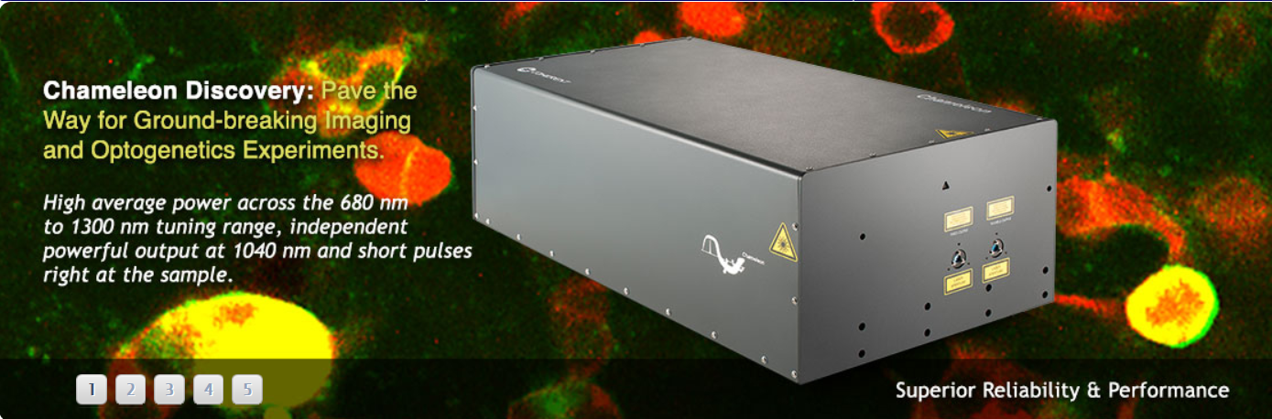
New: Chameleon Discovery

Slide 10
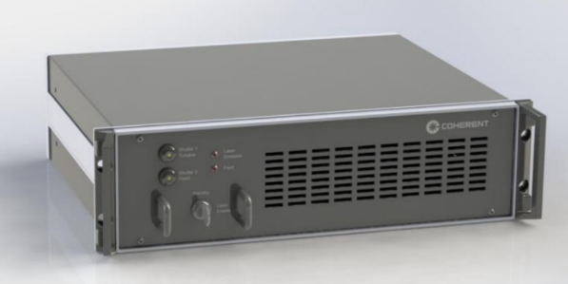
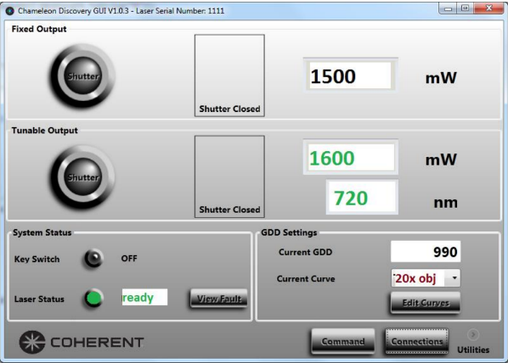
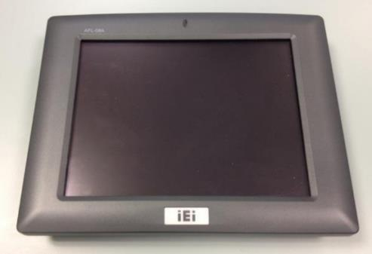
New: Chameleon Discovery
1. Outlet: Tuningrange: 680 – 1300nm
2. Outlet: fix @ 1040nm / 1,5W / 160fs
Pulse Length: 100fs
GDD - Unit
Control via PanelPC

Slide 11
New: Chameleon Discovery - Specials
DPSS UF Pump Source @ 1040nm
Seed/Amplifier
Internal OPO pumping
Both Outlets are synchronuous ➔
Ideal for CARS, SRS & Frequency mixing

Slide 12
VPUF – Laser Basics
VPUF: Verdi Pumped UltraFast Resonator
Passive Pulse generation of a Ti:Sa crystal
Kerr Lens Modelocking (KLM)
Self focusing: very high intensity (NLO) changes index of refraction inside crystal
This changes resonator parameters like divergence & beam waist.
Starter kick for pulse process required.
Wavelength Tuning via BRF (Mira) & Prism shift (Chameleon) possible
Small window with less losses, large areas with high losses

Slide 13
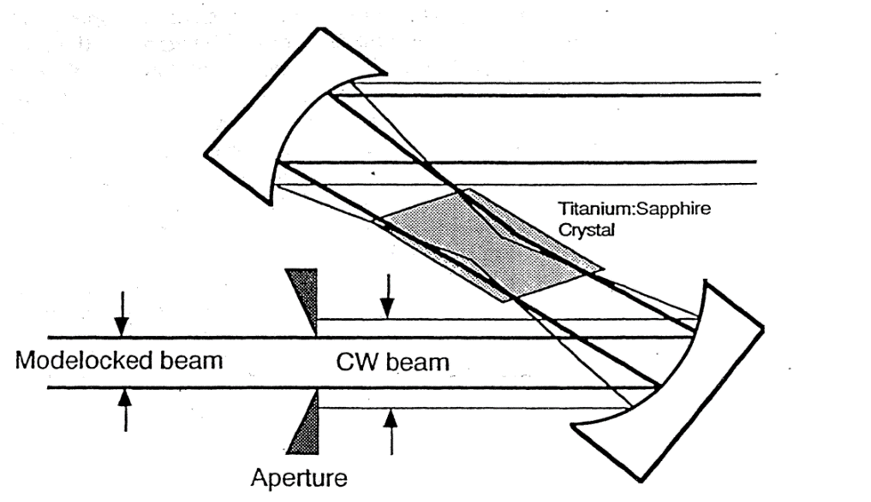
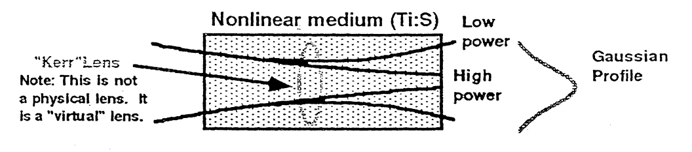
Kerr Lens Modelocking (KLM)

Slide 14
CW-Breakthrough & Q-Switching

Slide 15
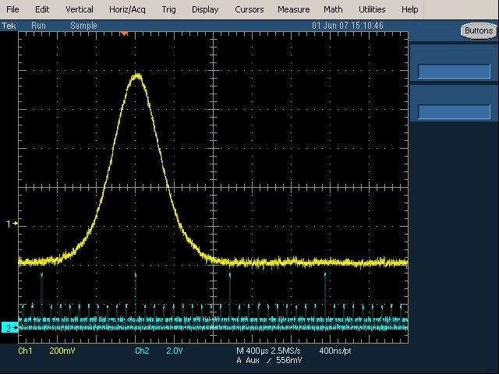
CW-Breakthrough & Q-Switching
REES measurement: Acceptable spectrum

Slide 16
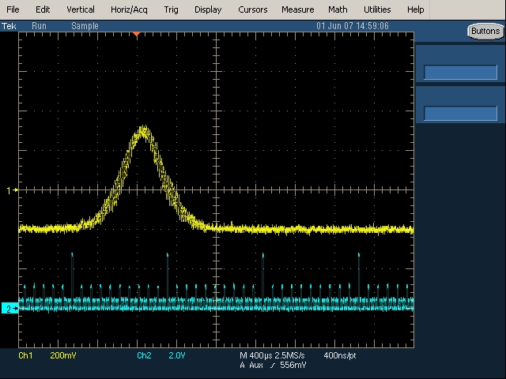
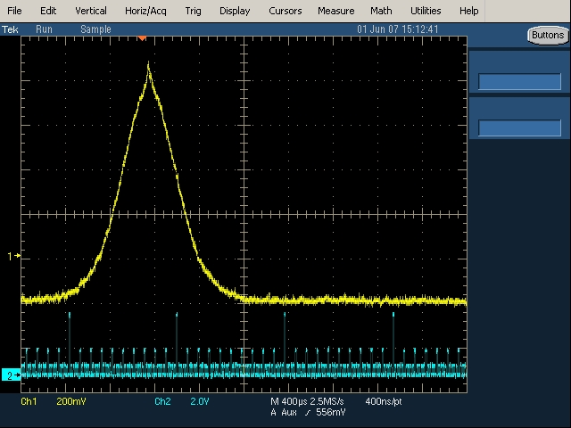
CW-Breakthrough & Q-Switching
REES measurement: Unacceptable spectra
Q-Switching
CW-Breakthrough

Slide 17
Tuning Kalibration

Slide 18
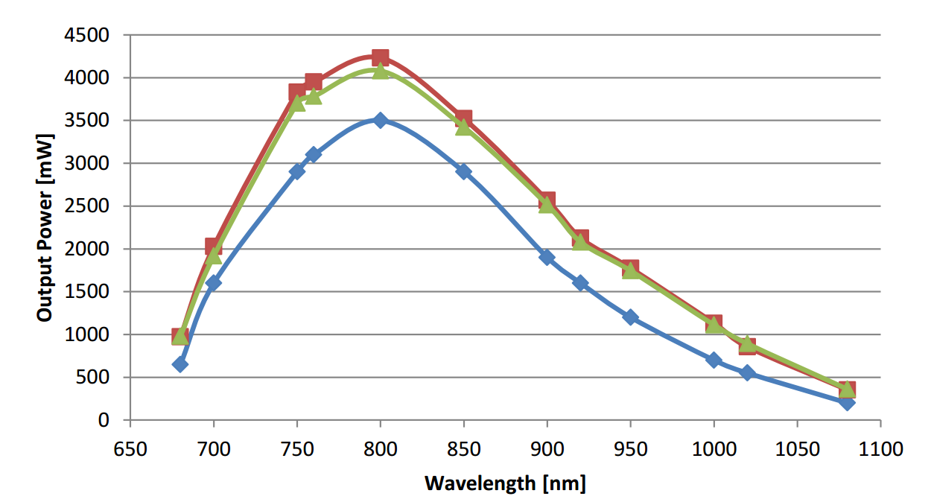
Typical Tuning Curve

Slide 19
Chameleon Laser Head
PPT
VERDI
sealed head
Pump optics
VPUF, sealed head
OC
CPT
Tunable ultra-fast Ti:s cavity
(utilizing Power Pulse system)
Verdi Pumped Ultrafast , VPUF
Cavity power track, CPT
Pump power track, PPT
Output Coupler, OC

Slide 20
Chameleon Laser Head – VPUF Cavity
Chameleon
Power Supply / Controller
Verdi™ CW green Pump Laser
Tuning slit
Active mirror^{[1]}
Photo -diode
Ti:S rod
Active mirror^{[1]}
Movement of combined prism/ slit determines GVD (λ) and hence τ(λ). Our choice of axis gives minimal τ(λ). ^{[2]}
Output
KLM slit

Slide 21
Differences between 90 & 80MHz Platforms
90MHz: 210nm & XR
80MHz: All Ultra & Vision
FSB 468:
1. The physical differences internal and external to the Chameleon
head and power supply.
2. The operational differences from both an operator and a Service
Engineer’s perspective.
3. The changes incorporated with the new Chameleon software.
4. The changes incorporated with the new Chameleon hardware.

Slide 22
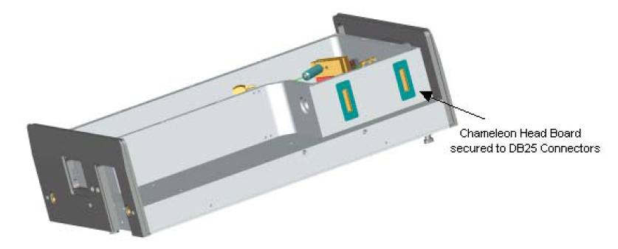
Differences between 90 & 80MHz Platforms
90MHz:
Pumplaser: V10, V12
Analogue Headboard on top of resonator
Black umbilical between PSU & Head
80MHz:
Pumplaser: V18
Digital Headboard beside
Separate cables & fibers
Front Panel User Menu / GUI

Slide 23
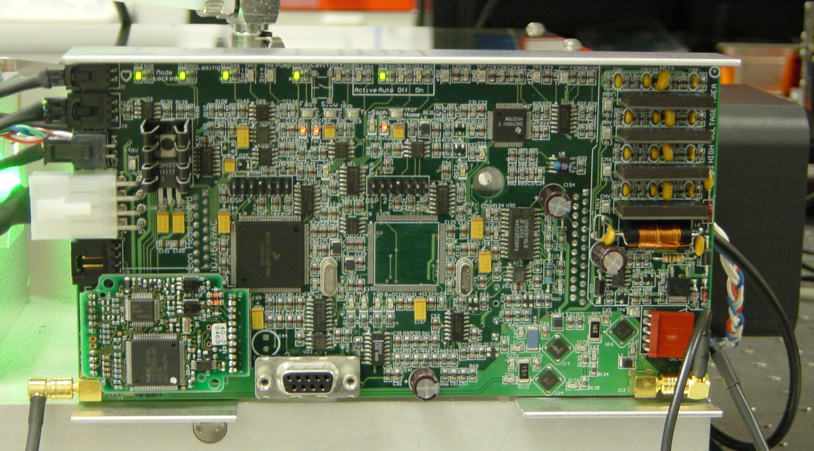
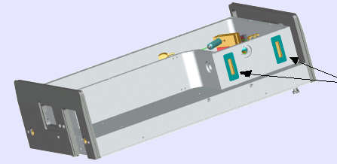
Differences between 90 & 80MHz Platforms
Ultra Digital Head Board

Slide 24
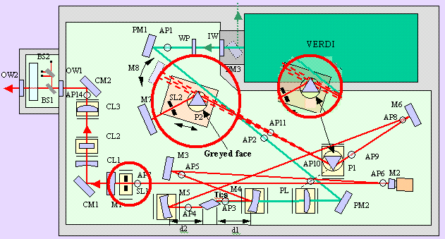
Differences between 90 & 80MHz Platforms
Ultra: Change to cavity layout

Slide 25
Operational Differences
90MHz Platform
Set Temperature is 25°C
Mirror positions are displayed: 0-5 V
80MHz Platform
Set Temperature is 25°C
Significant changes to user & service menu navigation
Chameleon software in foreground
Powermap now a software routine
Mirror positions are displayed: -100% - +100%
ML slit control

Slide 26
Recovery / Initialise
Recovery
90MHz platform only
Tunes to peak wavelength & scans PZTs for optimum alignment
Initialise
80MHz platform only
Tunes to peak wavelength & scans PZTs for optimum alignment

Slide 27
Function of Pump & Cavity PZT’s
Electronical adjustment of mirror positions
Px, Py: Verdi beam adjustment (x: horizontal, y: vertical)
Cx, Cy: Ti:Sa cavity mirror adjustment

Slide 28
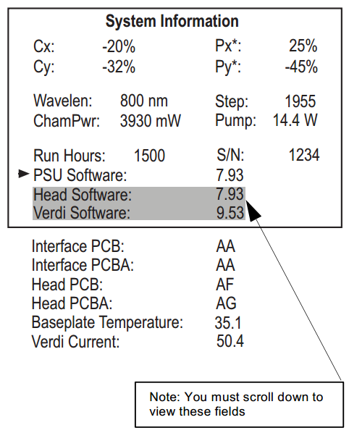
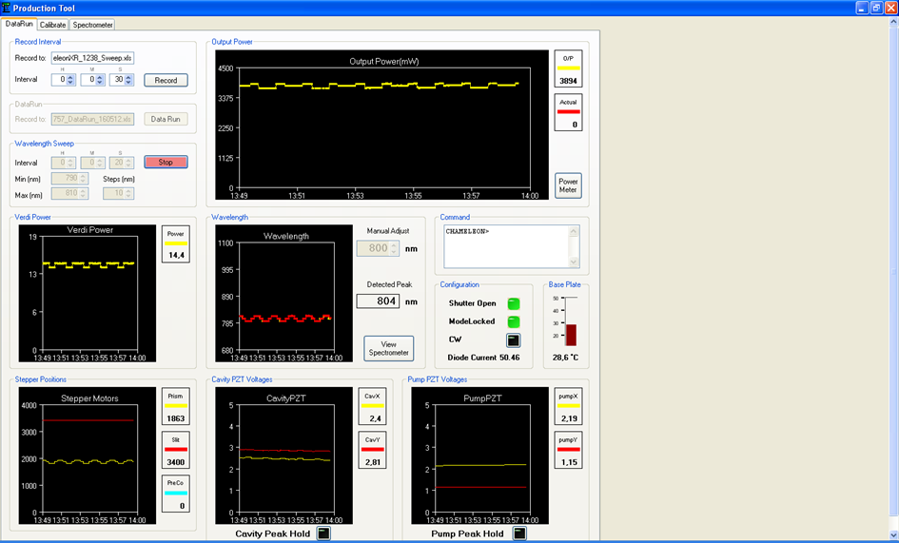
Pump & Cavity PZT’s
Check of mirror positions on Front Panel & GUI

Slide 29
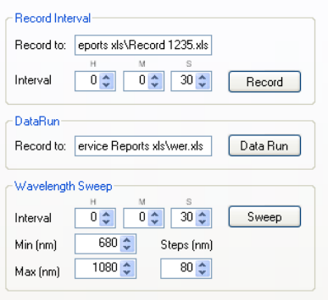
Tab Tune: λ - Sweep
Mirror optimization ➔ Power increase
Customer accessable

Slide 30
Laser Safety Review
Service Manual, Section 1.1
Operator Manual, Section 2
Setup: class 1 (fully covered beam), class 4 (open beam)
Setup: table walls, lab windows, curtains, customer goggles
Training: FSE yearly LS training, customer needs “Laser Safety Officer”
Laser Features: Interlocks, Shutter, Warning Lamp

Slide 31
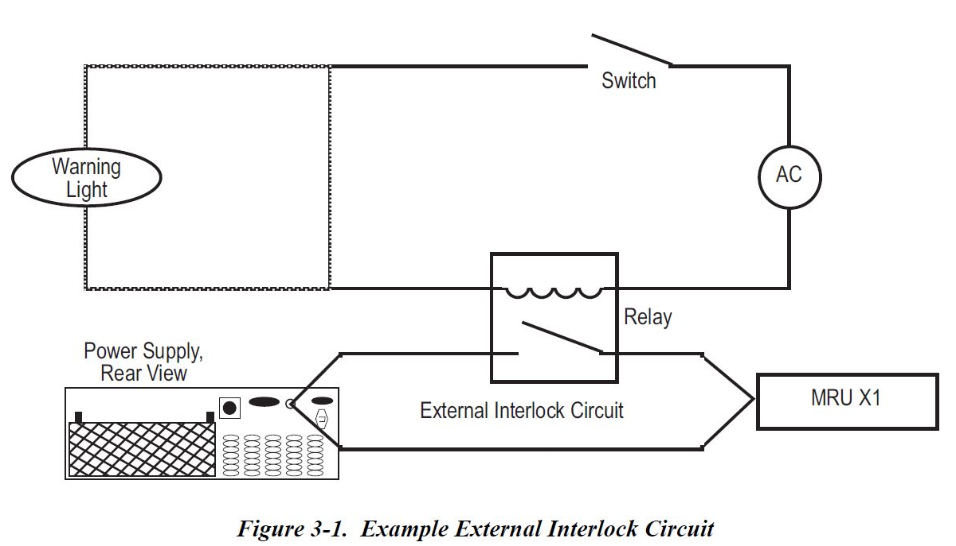
Laser Safety Features
Three Interlock – Circuits
Verdi Head Interlock: Laser Emission Lamp
Power Supply Interlock: Cover open
External Interlock: MRU, Lab Door,…
Shutter

Slide 32
